Slide 1
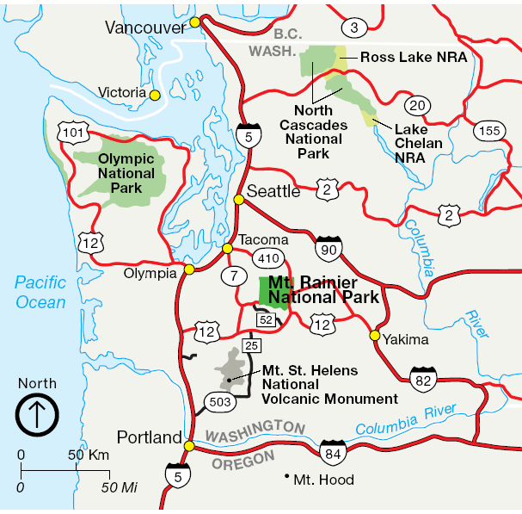
Notes:
Mount Rainier National Park is located about a hundred miles southeast of Olympic National Park and about 50 miles north northeast of Mt. St. Helens. It is even closer still to Tacoma, Washington – a city of about 200,000 people who are well within the radius considered at risk when this volcano erupts again.

Slide 2
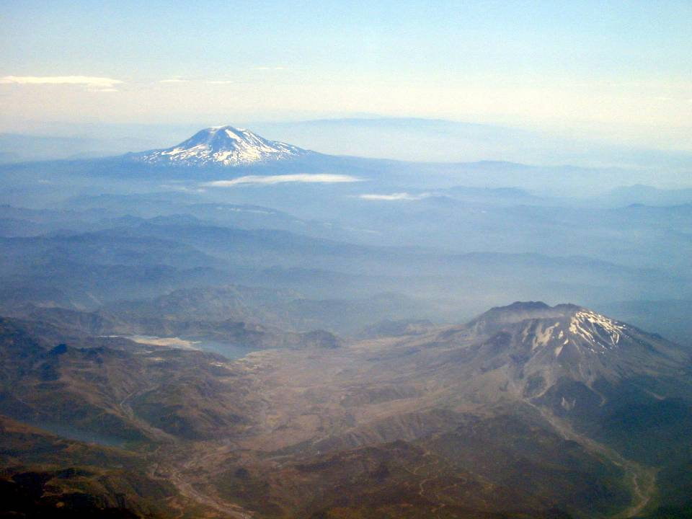
Notes:
Looking north from Mt. Saint Helens we can see Mt. Rainer protruding majestically above the snow level …

Slide 3
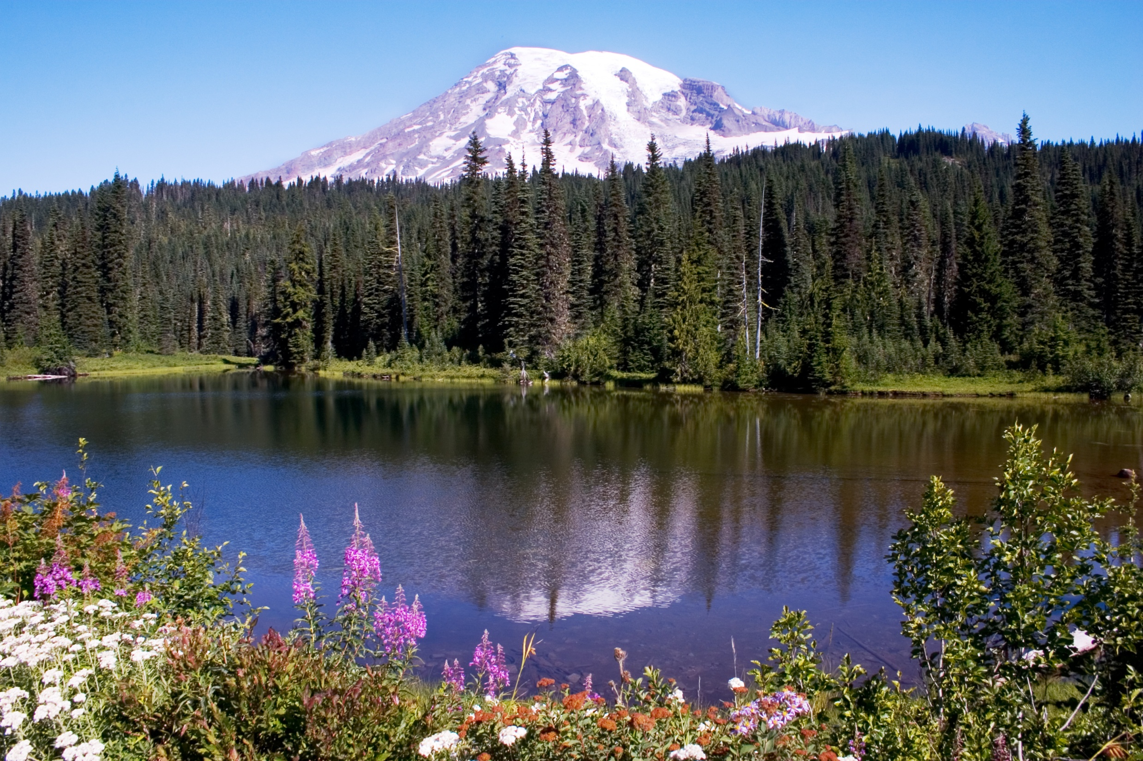
Notes:
… to an elevation of 14, 411 feet …

Slide 4
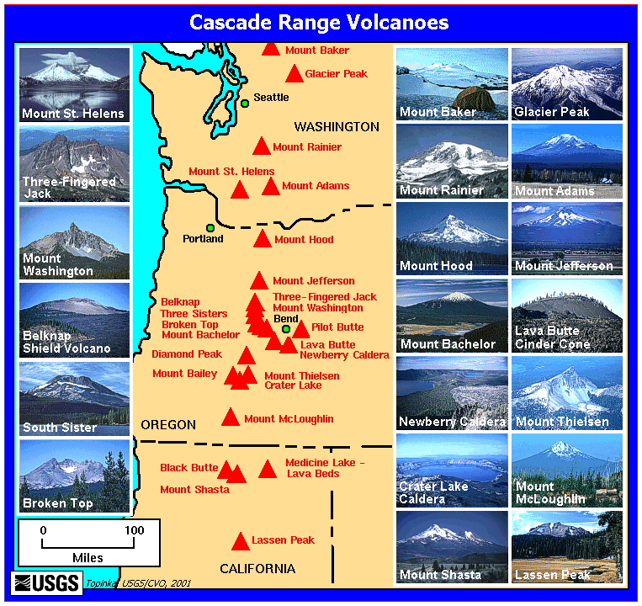
Notes:
… making it the highest mountain in the Cascade Ranges. Following this lesson on Mt. Rainier, we will examine two other volcanoes in the Cascades – Crater Lake and Mount Lassen.

Slide 5
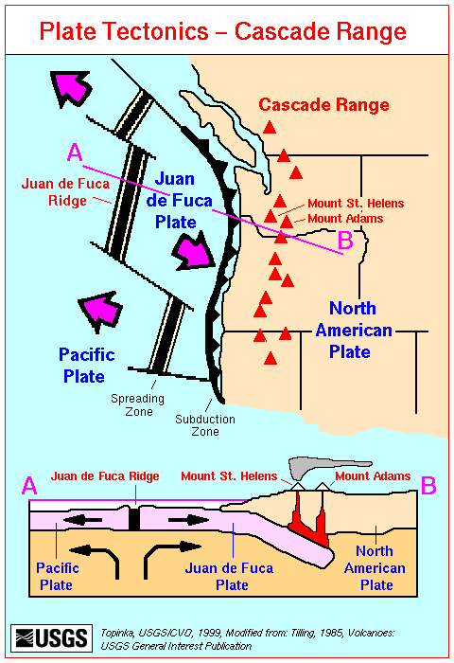
Notes:
Although all of the Cascadian volcanoes formed from magma generated by the subduction of the Juan de Fuca Plate beneath the North American Plate,

Slide 6
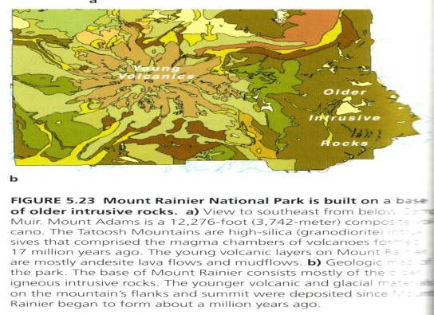
Unique Characteristics:
Granodiorite bedrock
90% Andesite lava flows
14,411 feet high
Notes:
… Mount Rainier has several characteristics that set it apart from the rest of the Cascadian volcanoes. First up, the volcanic rocks here rest atop granodiorite bedrock. This indicates that before Mt. Rainier formed, some pre-existing volcano was uplifted and eroded, exposing its plutonic roots.

Slide 7
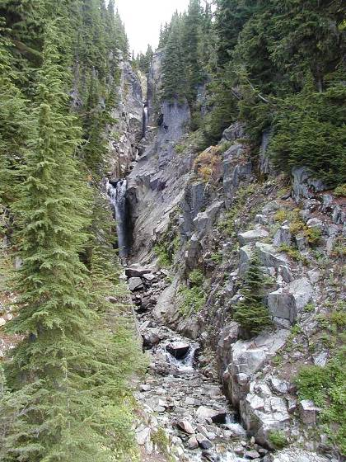
Unique Characteristics:
Granodiorite bedrock
90% Andesite lava flows
14,411 feet high
Notes:
Second, the composition of this volcano is remarkably consistent. Unlike other composite volcanoes which have a fairly equal ratio of lava to pyroclastics, 90% of Mt. Rainier is comprised of andesite lava flows.

Slide 8
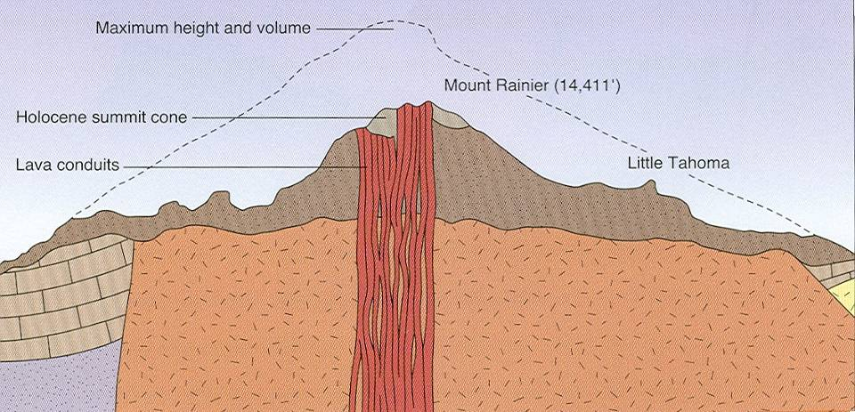
Unique Characteristics:
Granodiorite bedrock
90% Andesite lava flows
14,411 feet high
Notes:
Third, at 14,411 feet, Mt. Rainier is unusually high for a Cascadian volcano, although as you can see from projecting upward the slope of less eroded lava flows near its base, the mountain was even higher before erosion. All of these unique characteristics are related. The uniform granodiorite bedrock probably made the formation of a near surface magma reservoir unlikely. Seismic studies do indicate a magma chamber under Rainier, but at about 8 kilometers down it is relatively deep. Without the cooling afforded by a shallow magma chamber, there would be less opportunity for magmatic differentiation to occur and consistently andesitic magma would feed the volcano directly from the zone of wet melting above the subduction zone. Magma consistency is further maintained because the chemical composition of granodiorite is pretty similar to andesite, so partial melting of the wall rocks would not alter the composition of the magma much either. Most of the gas in the andesitic magma would be released in massive Vesuvian-type eruptions which would deposit ash far and wide, leaving relatively little pyroclastic material on the volcano. A long period of effusive volcanism would follow, producing the andesite flows which comprise the bulk of the volcano. Mount Rainier is higher than other Cascadian volcanoes because flows are more resistant to erosion than pyroclastics.

Slide 9
“like bubbles in spaghetti sauce”
Notes:
Eruption frequency varies considerably across the Cascadian volcanoes. Note the numerous eruptions of Mt. St. Helens over the last 4,000 years. It’s not surprising that native Americans that have lived in the vicinity of Mt. St. Helens during this period have past-down an awesome respect for the volcano in their tribal legends. The varying eruption frequency indicates that magma formed over subduction zone will have a higher preference for certain well-established conduits to the surface, much in the same way bubbles will reappear in the same spot over and over in simmering spaghetti sauce. Note that Mt. Rainier has a pretty typical eruption frequency relative to other Cascadian volcanoes. Furthermore, it has erupted in the last 200 years.

Slide 10
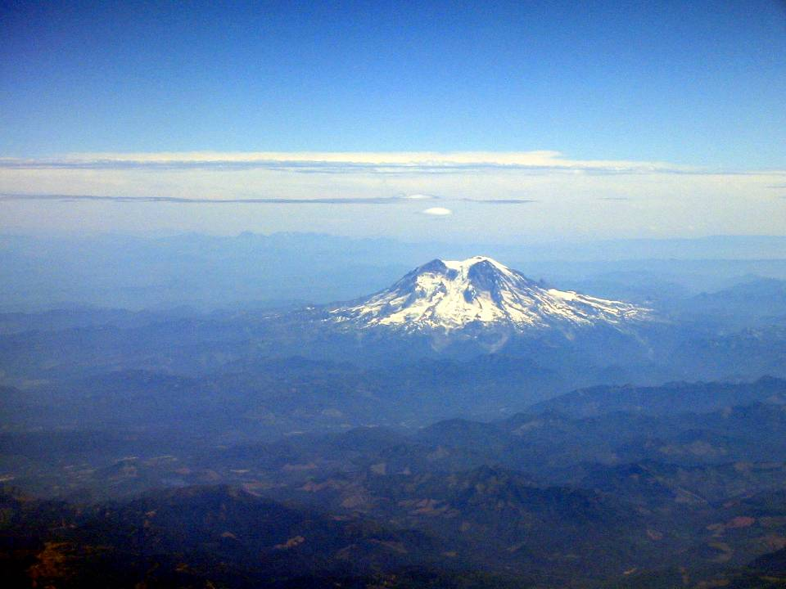
Notes:
Because Rainier erupted relatively recently, its overall shape is a relatively symmetrical cone.

Slide 11
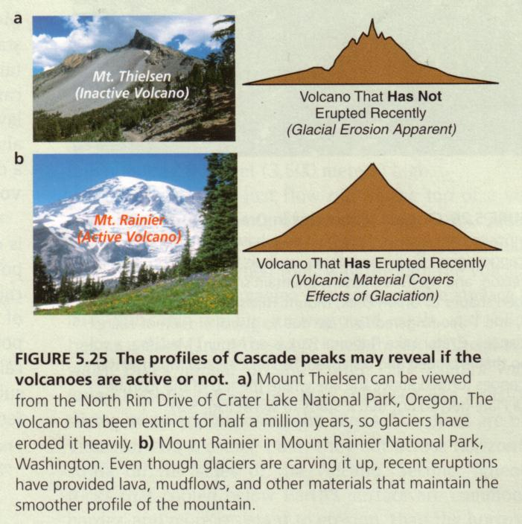
Notes:
A volcano that has not erupted recently will have a much more irregular shape due do prolonged erosion from streams and glaciers.

Slide 12
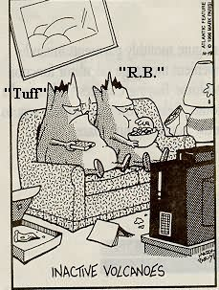
Notes:
The longer the period of inactivity, the more magma will harden in the volcano’s conduits, and the more likely the volcano is to become completely extinct.

Slide 13
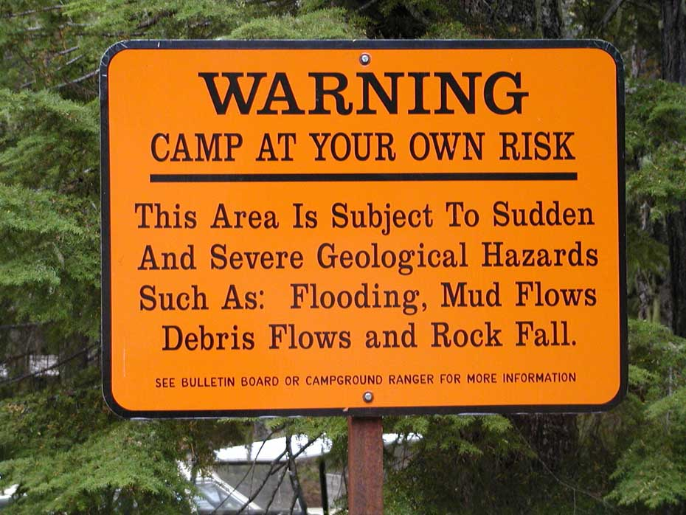
Notes:
The most recent recorded eruption of Mt. Rainier was between 1820 and 1854, but many eyewitnesses reported sporadic activity between 1858 and 1894 as well. It is only a matter of time before this volcano erupts again, so the associated geologic hazards are taken very seriously in the park.

Slide 14
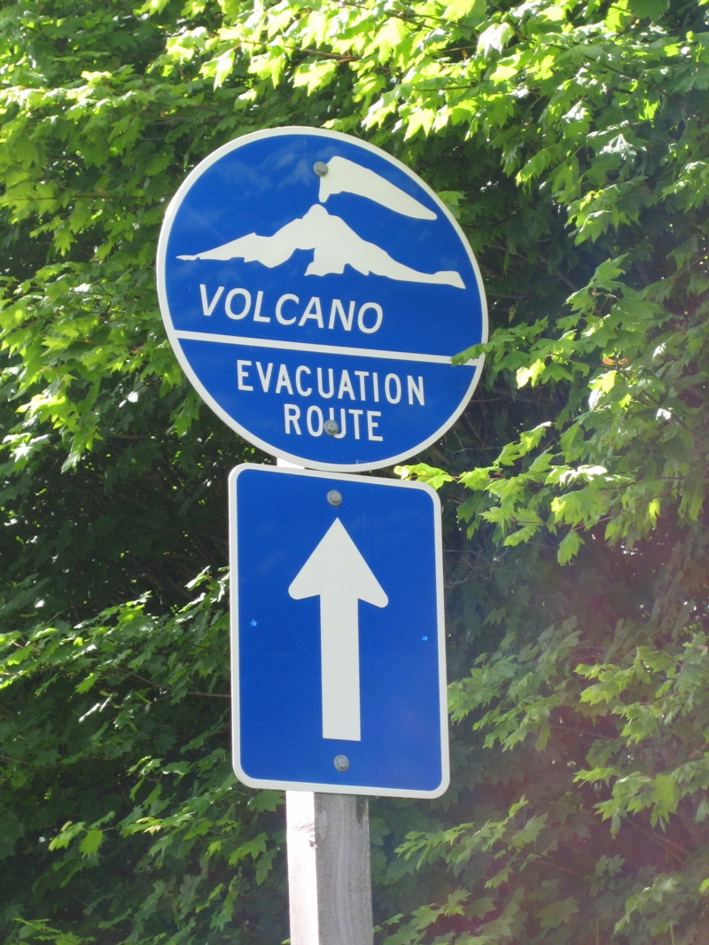
Notes:
There are even posted evacuation routes.

Slide 15
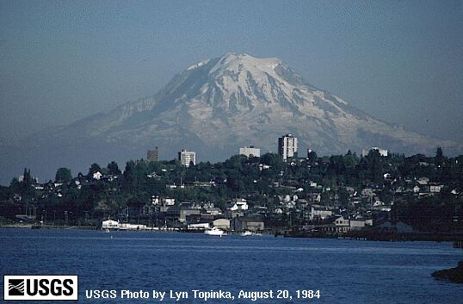
Mount Rainier from Tacoma, WA.
Notes:
The looming specter of volcanic disaster is particularly ominous in Tacoma, Washington. From this vantage point the enormous amount of gravitational potential energy of the volcano relative to sea level is unsettlingly apparent.

Slide 16
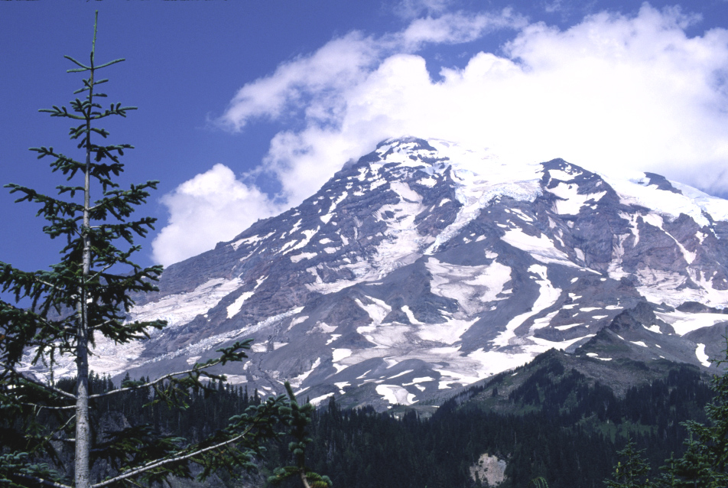
14,411 feet
Notes:
The fact that Mount Rainier is well over 14,000 feet high also means that …

Slide 17
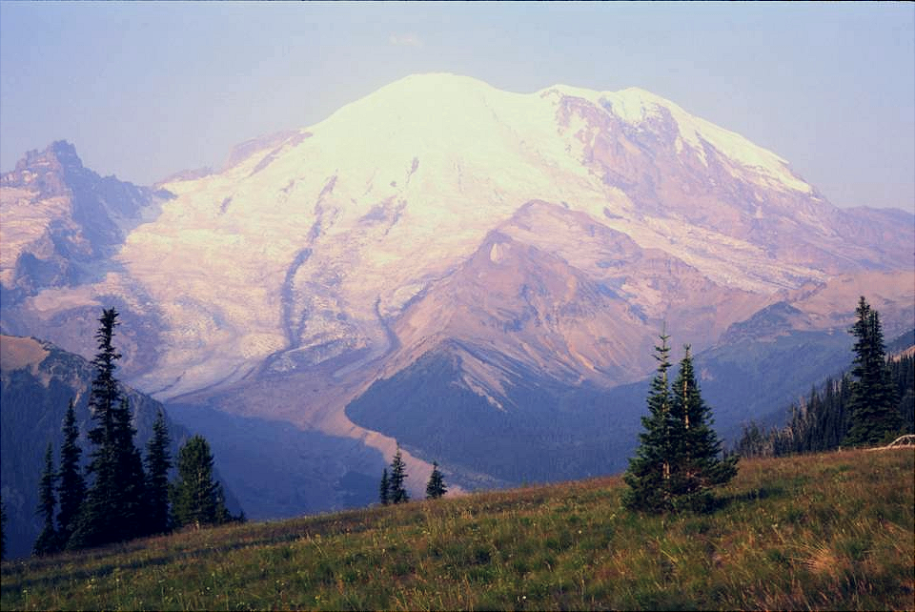
Emmons Glacier
Notes:
… the top of Mt. Rainier is glaciated.

Slide 18
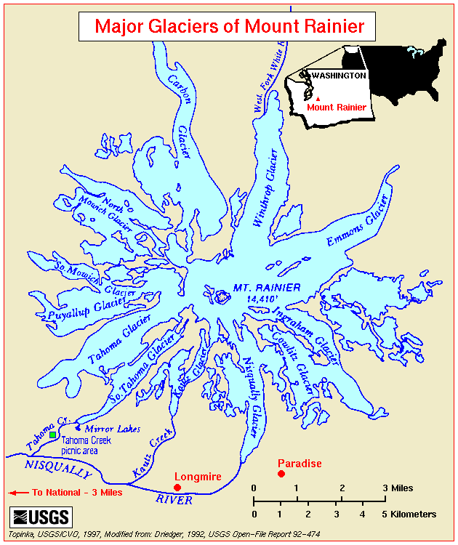
Notes:
Indeed, there are more than a dozen named glaciers carving away at Rainier’s summit. Glaciers and volcanic eruptions combine…

Slide 19
Mt. Rainier Hazards
Lahars
Glacial outburst floods
Sector collapse
Lava and pyroclastic flows
Ash fall
Notes:
… to form devastating volcanic debris flows known as lahars.

Slide 20
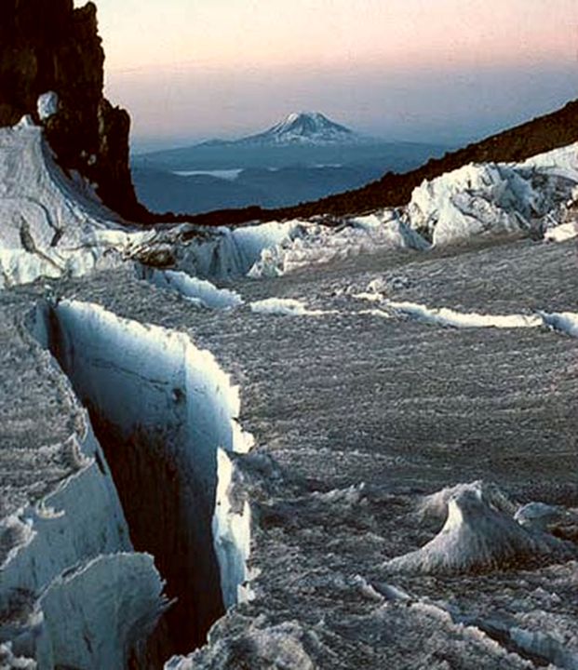
Notes:
Lahars form when snow and or glacial ice on a volcano …

Slide 21
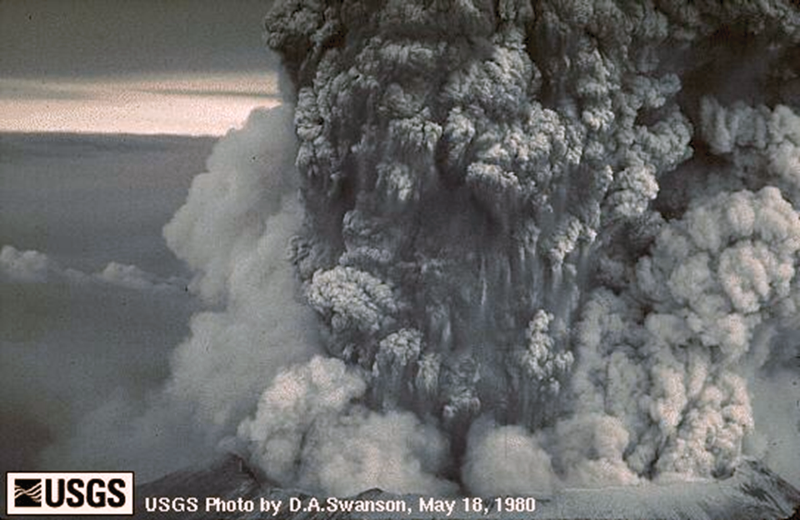
Notes:
… melt upon contact with a rain of hot, pyroclastic particles …

Slide 22
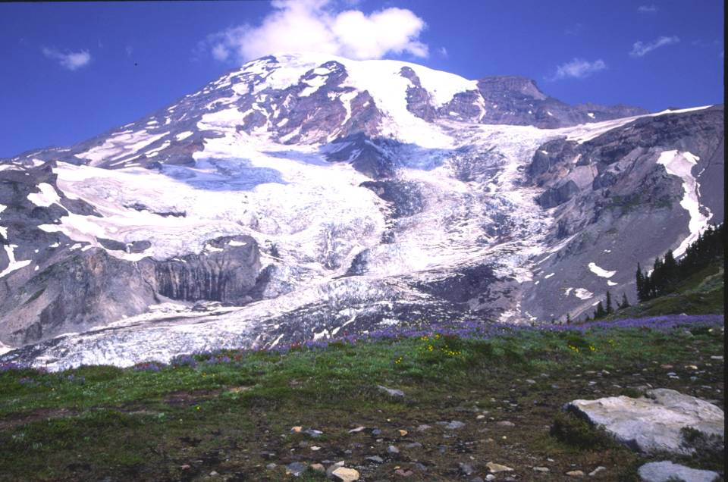
Notes:
… forming a slurry of rock, ash and water which flows rapidly down the steep slopes of the volcano..

Slide 23
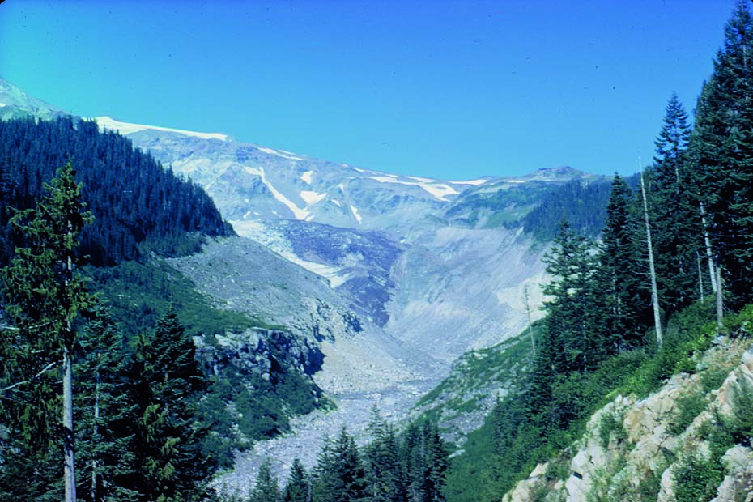
Nisqually Valley
Notes:
Mount Rainier has experienced repeated lahars including this one which devastated the Nisqually Valley …

Slide 24
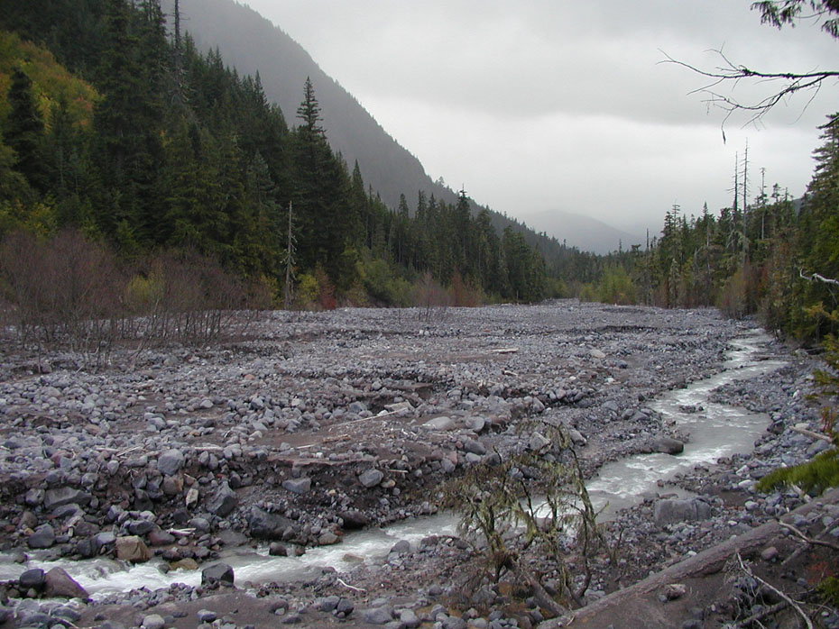
Notes:
… and deposited this mass of unsorted volcanic debris downstream near Cougar Rock Camp.

Slide 25
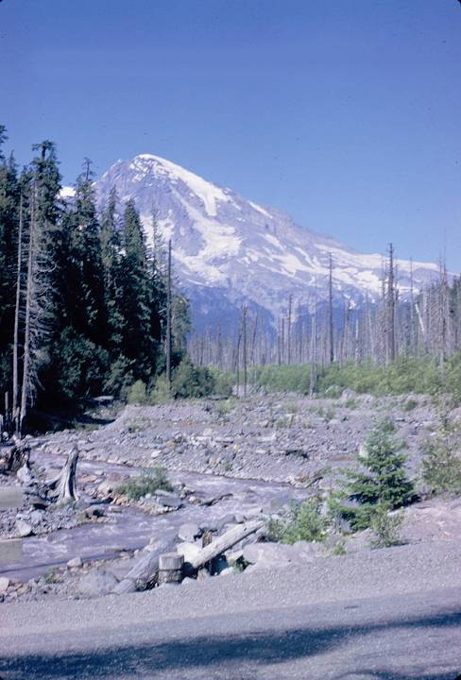
Notes:
Another lahar killed these trees in Kautz Creek.

Slide 26
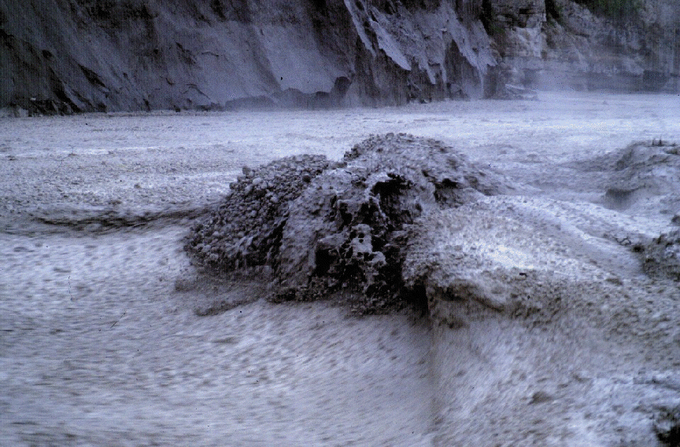
Notes:
Lahars move rapidly with a viscosity similar to wet concrete. This is not a situation that one could outrun or swim free of.

Slide 27
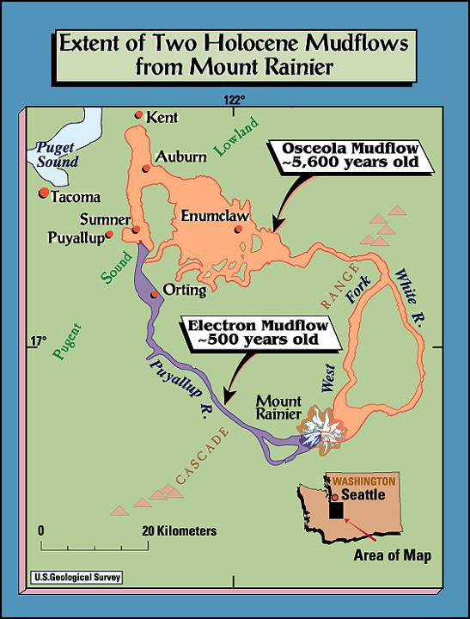
Notes:
Lahars are especially dangerous because they can be lethal at far greater distances relative to other volcanic hazards. The ancient Electron and Osceola lahars flowed more than 40 and 70 miles from Mt. Rainier respectively.

Slide 28
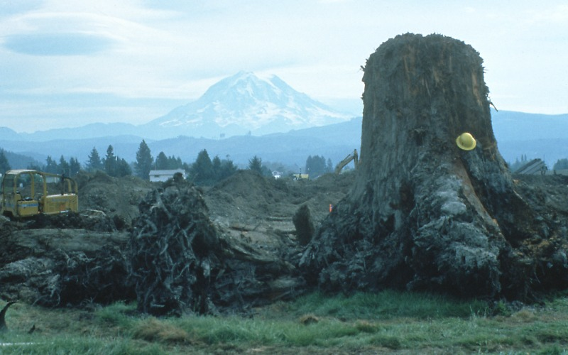
Notes:
This tree stump was buried by the Electron lahar about 500 years ago. With Mount Rainier in the background, this photo gives you a good idea of the long run-out possible for lahars.

Slide 29
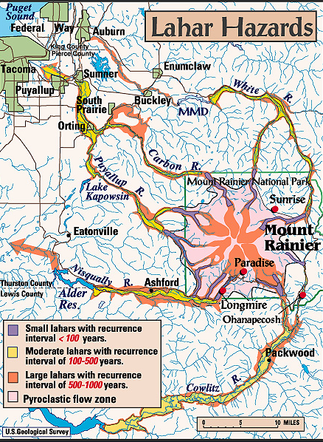
Notes:
Fortunately, with a recurrence interval between 500-1000 years, such long run-out lahars are relatively infrequent. Small lahars are much more frequent, and because near the volcano they are just as deadly, they’re probably the greatest volcanic threat to visitors of Mount Rainier National Park.

Slide 30
Mt. Rainier Hazards
Lahars
Glacial outburst floods
Sector collapse
Lava and pyroclastic flows
Ash fall
Notes:
Glacial outburst floods are far more common than lahars, but they are not as far reaching in their effects.

Slide 31
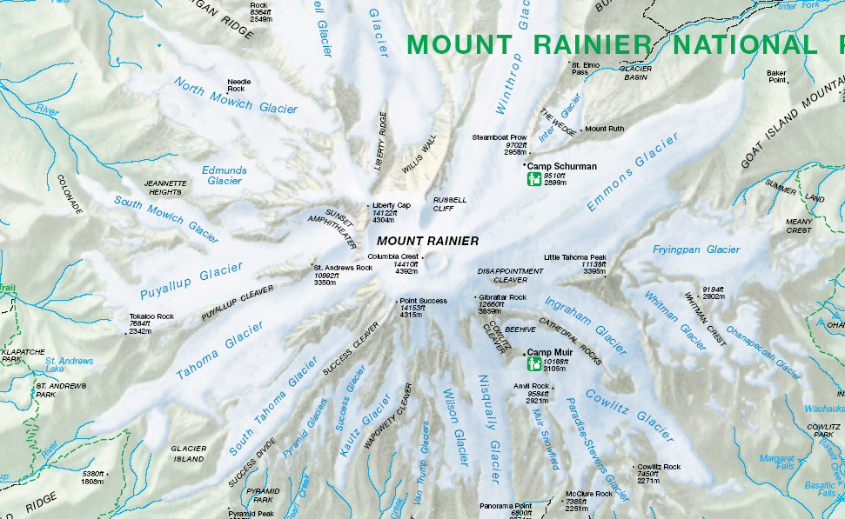
Notes:
Outburst floods at Mount Rainier form from the sudden release of water stored at the base of glaciers or within the glacier ice and are not related to volcanic activity.

Slide 32
Notes:
South Tahoma Glacier has been particularly dangerous in the last two decades - releasing about one outburst flood every year. Floods typically occur during periods of unusually hot or rainy weather in summer or early autumn, apparently because of rapid input of melt water or rainwater to the base of the glacier.

Slide 33
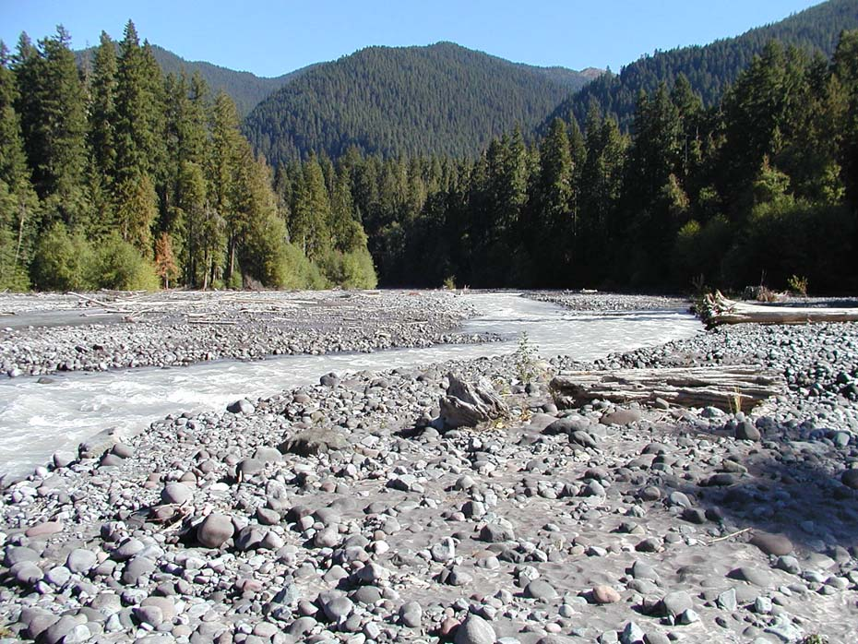
Notes:
Glacial melt water typically has a milky appearance due to the presence of fine, glacially-pulverized particles known as rock flour. This is generally the type of water which comprises outburst floods.

Slide 34
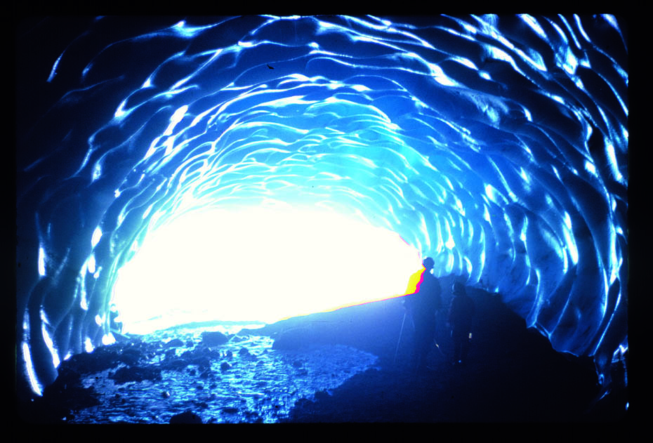
Paradise Ice Cave
Notes:
The flow of water under the park’s glaciers isn’t all bad. In several places it initiated the formation of ice caves which later where enlarged mainly by air flow through the cave. Although at one time there were over 8 miles of passages mapped and they were considered the longest ice caves on earth, Rainier’s glaciers have melted back considerably, and by one report, only about a hundred feet of the cave remains.

Slide 35
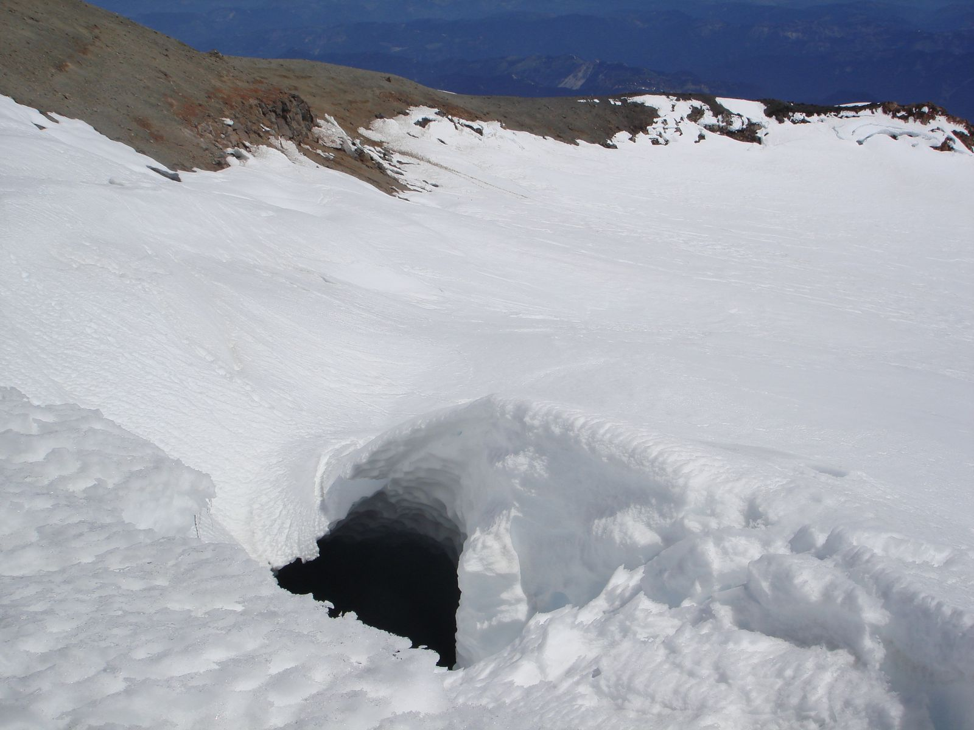
Notes:
Not to be confused with the ice caves are the steam caves, which are formed by fumaroles near the summit crater.

Slide 36
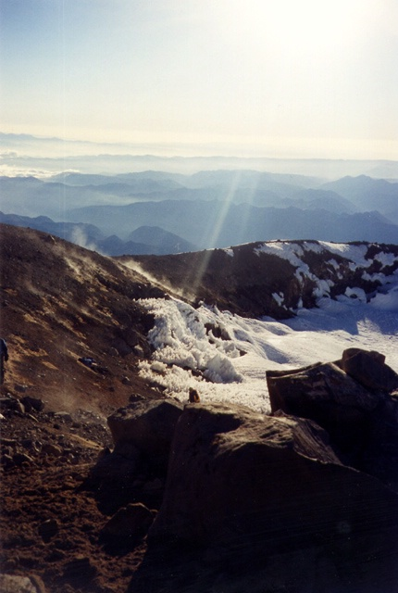
Steam rising from summit crater fumaroles
Notes:
Although mostly steam, the volcanic gases emanating from the volcano’s numerous fumaroles are rich in corrosive vapors like sulfuric acid.

Slide 37
Mt. Rainier Hazards
Lahars
Glacial outburst floods
Sector collapse
Lava and pyroclastic flows
Ash fall
Notes:
Such hot, corrosive vapors weaken the volcanic rock near the summit promoting the gravitational collapse of a portion or sector of the volcano.

Slide 38
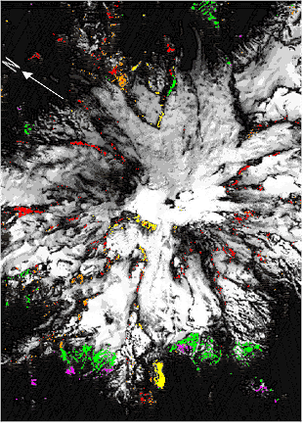
Hydrothermal alteration
Notes:
Sector collapse is a threat wherever such hydrothermal alteration has occurred.

Slide 39
Mt. Rainier Hazards
Lahars
Glacial outburst floods
Sector collapse
Lava and pyroclastic flows
Ash fall
Notes:
Although not the most common of Mount Rainier’s geologic hazards, lava and pyroclastic flows are probably the most feared. After all, who wants to burn to death?

Slide 40
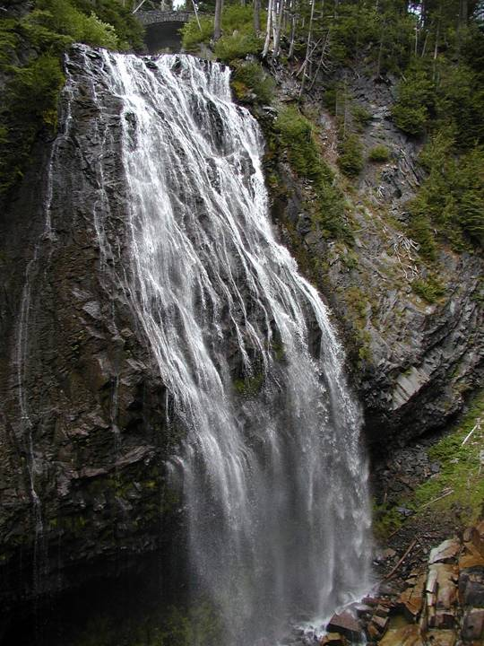
Andesite
Notes:
Narada Falls cascades over one of the ubiquitous andesite lava flows that built Mount Rainier.

Slide 41
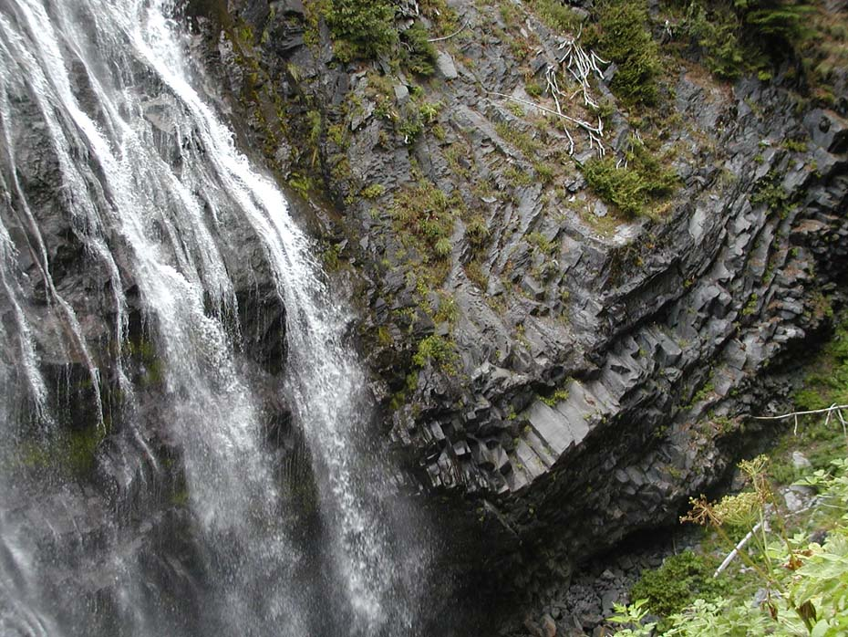
Columnar jointing
Notes:
A closer look reveals columnar jointing formed by thermal contraction. Although this lava was once hot enough to vaporize fresh, the relatively high viscosity of andesitic magma means that anything faster than a snail could probably avoid being overtaken by one of these flows.

Slide 42
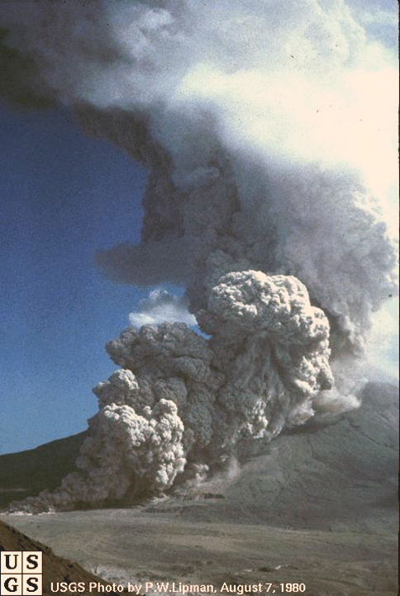
Notes:
Pyroclastic flows are different. They originate from coarse pyroclastics that fall near the vent and then tumble down the volcano’s slopes as searing avalanches that can reach speeds of 200 mph.

Slide 43
Notes:
Unlike lahars, the area potentially affected by lava and pyroclastic flows is limited to about 5-10 miles from the summit.

Slide 44
Mt. Rainier Hazards
Lahars
Glacial outburst floods
Sector collapse
Lava and pyroclastic flows
Ash fall
Notes:
Ash falls are the least deadly but most far-reaching of Rainier’s potential hazards.

Slide 45
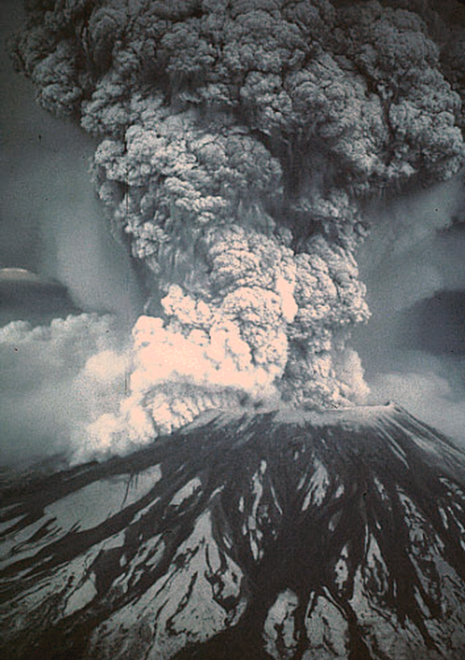
Notes:
This photo of the 1980 eruption of Mt. Saint Helens’ shows a typical Vesuvian-type eruption blasting ash high into the troposphere …

Slide 46
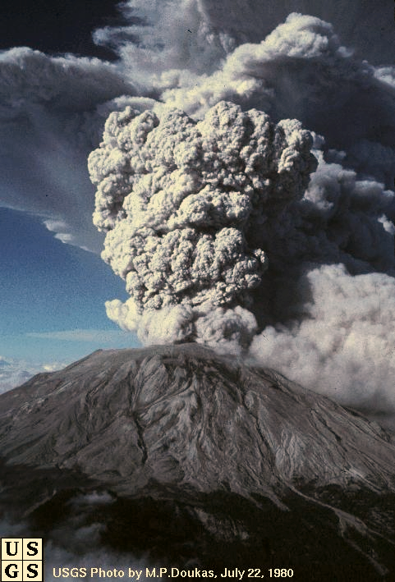
Notes:
… where the jet stream can carry the volcanic ash for hundreds of miles.

Slide 47
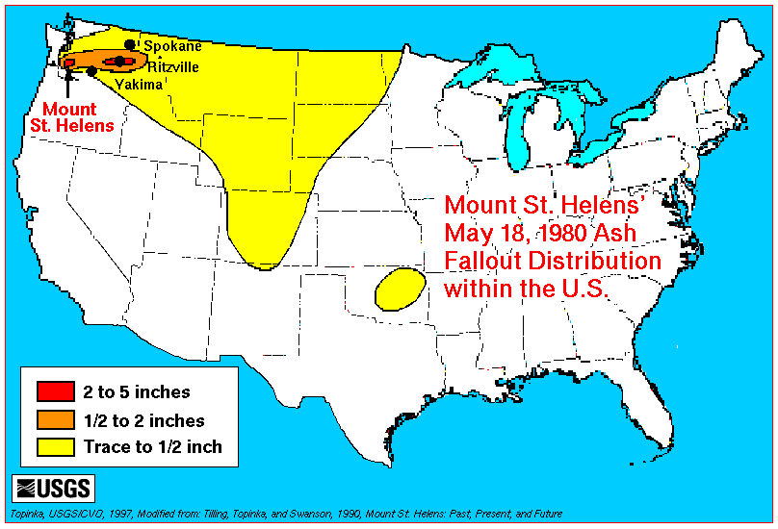
Notes:
Near the volcano ash fallout will obviously be greater …

Slide 48
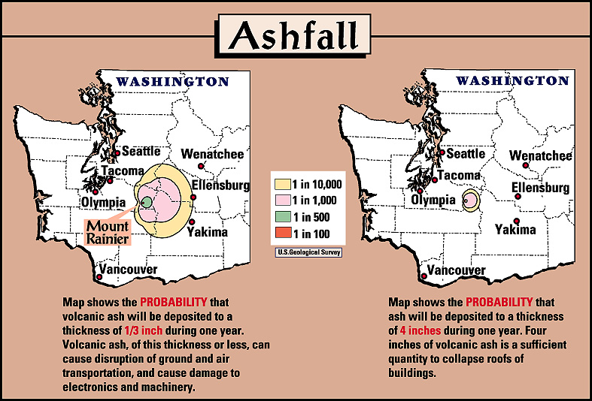
Notes:
… where the most common hazard is the disruption of ground and air transportation. However, if ash thickness exceeds 4 inches, roofs may collapse.

Slide 49
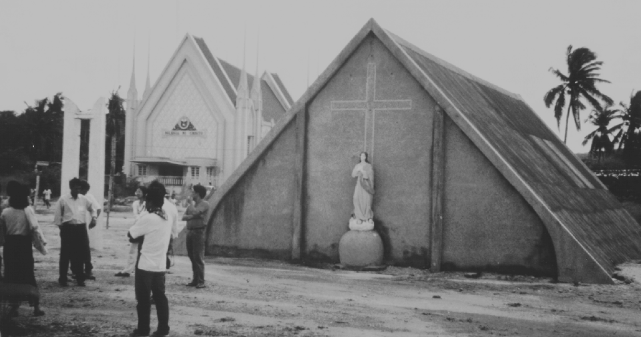

Slide 50
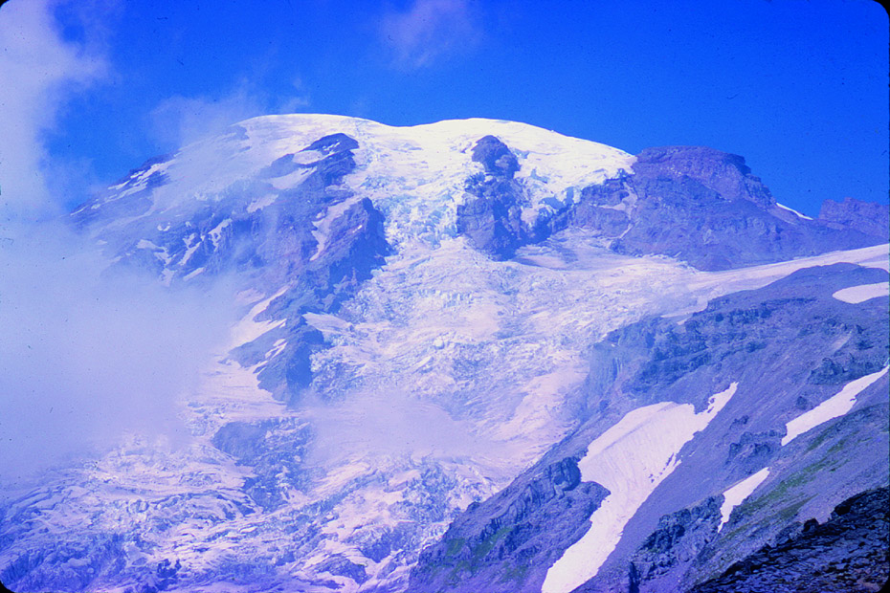
Notes:
Mount Rainier 17 AJ Nisqually Glacier

Slide 51
